Slide 1
Heart Disease Diagnostic Analysis

Slide 2
Introduction - Problem Statement
Health is real wealth in the pandemic time we all realized the brute effects of covid-19 on all irrespective of any status. You are required to analyze this health and medical data for better future preparation.
Do ETL: Extract- Transform and Load data from the heart disease diagnostic database. You can perform EDA through python. The database extracts various information such as Heart disease rates, Heart disease by gender, by age. You can even compare attributes of the data set to extract necessary information. Make the necessary dashboard with the best you can extract from the data. Use various visualization and features and make the best dashboard. Find key metrics and factors and show the meaningful relationships between attributes. Do your own research and come up with your findings

Slide 3
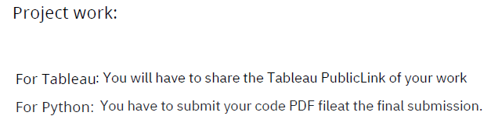
Details of Data
For Tableau :
https://public.tableau.com/app/profile/kulbhushan.huparikar/viz/HeartDiseaseDiagnosticAnalysis_17018611754520/HeartDiseaseDiagnosticAnalysis?publish=yes
For Python :
PDF file of EDA of Project Submitted with this File in final Submission.

Slide 4
Main KPIs
Attribute Information:
age age
sex sex
chest pain type (4 values) cp
resting blood pressure trestbps
serum cholestoral in mg/dl chol
fasting blood sugar > 120 mg/dl fbs
resting electrocardiographic results (values 0,1,2) restecg
maximum heart rate achieved thalach
exercise induced angina exang
oldpeak = ST depression induced by exercise relative to rest oldpeak
the slope of the peak exercise ST segment slope
number of major vessels (0-3) colored by flourosopy ca
thal: 0 = normal; 1 = fixed defect; 2 = reversable defect thal

Slide 5
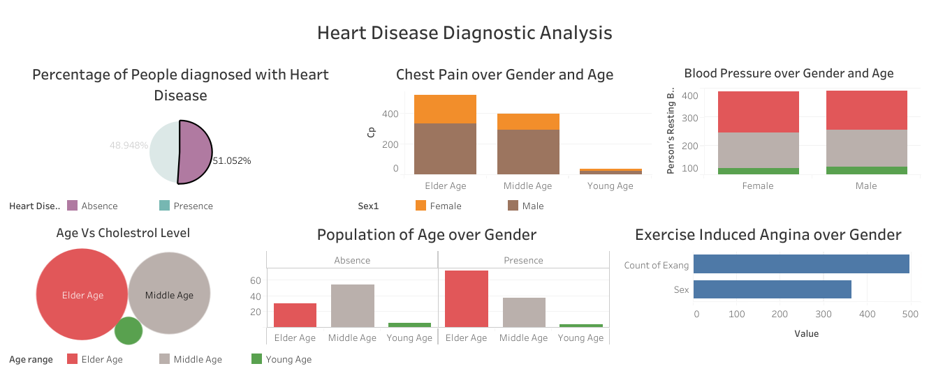
Dashboard

Slide 6
Key Points
In datasets of 1025, we have 498 individuals which are not having Heart disease and remaining 527 individuals suffering from Heart Disease.
Pie-Chart shows 51.5% suffering from heart disease.
Male are more prone to Heart Disease.
The people suffering from Heart Disease have non-Typical pain. Also we can see if people having Asymptomatic pain that doesn't mean people suffer from Heart Disease.
We can see that a higher number of men are suffering from Typical type of Chest Pain.
There is very high number of Typical Angina Pain in Elderly age Category.
Blood Pressure are almost same in Male and Female and Females have little bit of higher cholesterol than Males.
Higher Blood pressure prone to Heart Disease. Observation found that Blood Pressure increases between age of 50 to 60 and somehow continue the pattern till 70. Cholesterol level also increase after age of 50.
If you suffer from Angina, you may be concerned that exercise will make your Heart Disease symptoms worse. Males have high Exercise Angina. Angina is type of chest pain caused by reduced blood flow to the heart.
ST depression mostly increases between the age group of 30-40 and ST depression are more in Male compare to Female.
More ST depression then more prone to Heart Disease.

Slide 7
Thank you

